Slide 1
CSCE430/830 Computer Architecture
Disk Storage Systems: RAID
Lecturer: Prof. Hong Jiang
Courtesy of Yifeng Zhu (U. Maine)
Fall, 2006
Portions of these slides are derived from:
Dave Patterson © UCB

Slide 2
Overview
Introduction
Overview of RAID Technologies
RAID Levels

Slide 3
Why RAID?
Performance gap between processors and disks
RISC microprocessor: 50% per/yr increase
Disk access time: 10% per/yr increase
Disk transfer rate: 20% per/yr increase
RAID: a natural solution to narrow the gap
Stripping data across multiple disks to
allow parallel I/O, thus improving performance
What is the main problem if we organize dozens of disks together?

Slide 4
Array Reliability
Reliability of N disks = Reliability of 1 Disk ÷N
  50,000 Hours ÷ 70 disks = 700 hours
Disk system MTTF: Drops from 6 years to 1 month!
Arrays without redundancy too unreliable to be useful!
RAID 5:
MTTF(disk) ²
mean time between failures = ------------------------------
N*(G-1)*MTTR(disk)
N - total number of disks in the system
G - number of disks in the parity group

Slide 5
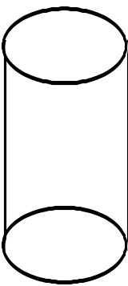
Overview of RAID Techniques
Disk Mirroring, Shadowing
1
0
0
1
0
0
1
1
1
0
0
1
0
0
1
1
Each disk is fully duplicated onto its "shadow"
Logical write = two physical writes
100% capacity overhead
Parity Data Bandwidth Array
1
0
0
1
0
0
1
1
1
1
0
0
1
1
0
1
1
0
0
1
0
0
1
1
0
0
1
1
0
0
1
0
Parity computed horizontally
Logically a single high data bw disk
High I/O Rate Parity Array
Interleaved parity blocks
Independent reads and writes
Logical write = 2 reads + 2 writes

Slide 6
Levels of RAID
6 levels of RAID (0-5) have been accepted by industry
Other kinds have been proposed in literature,
Level 6 (P+Q Redundancy), Level 10, etc.
Level 2 and 4 are not commercially available, they are included for clarity

Slide 7
RAID 0: Nonredundant
file data
block 0
block 1
block 2
block 3
Disk 0
Disk 1
Disk 2
Disk 3
Best write performance
due to no updating redundancy information
Not best read performance
Redundancy schemes can schedule requests on the disks with shortest queue and disk seek time

Slide 8
RAID 1: Disk Mirroring/Shadowing
recovery
group
Each disk is fully duplicated onto its "shadow"
Very high availability can be achieved
Bandwidth sacrifice on write:
Logical write = two physical writes
Reads may be optimized
minimize the queue and disk search time
Most expensive solution: 100% capacity overhead
Targeted for high I/O rate , high availability environments

Slide 9
RAID 2: Memory-Style ECC
b₀
b₁
b₂
b₃
f₀(b)
f₁(b)
P(b)
Data Disks
Multiple ECC Disks and a Parity Disk
Multiple disks record the ECC information to determine which disk is in fault
A parity disk is then used to reconstruct corrupted or lost data
Needs log₂(number of disks) redundancy disks

Slide 10
RAID 3: Bit Interleaved Parity
10010011
11001101
10010011
. . .
P
Striped physical
records
1 0 0 1 0 0 1 1 0
1 1 0 0 1 1 0 1 1
1 0 0 1 0 0 1 1 0
Logical record
Physical record
Only need one parity disk
Write/Read accesses all disks
Only one request can be serviced at a time
Provides high bandwidth but not high I/O rates
Targeted for high bandwidth applications: Multimedia, Image Processing

Slide 11
RAID 4: Block Interleaved Parity
block 0
block 1
block 2
block 3
P(0-3)
block 4
block 5
block 6
block 7
P(4-7)
block 8
block 9
block 10
block 11
P(8-11)
block 12
block 13
block 14
block 15
P(12-15)
Allow for parallel access by multiple I/O requests
Doing multiple small reads is now faster than before.
Large writes (full stripe), update the parity:
P’ = d0’ + d1’ + d2’ + d3’;
Small writes (eg. write on d0), update the parity:
P = d0 + d1 + d2 + d3
P’ = d0’ + d1 + d2 + d3 = P + d0’ + d0;
However, writes are still very slow since the parity
disk is the bottleneck.

Slide 12
RAID 4: Small Writes
Small Write Algorithm
1 Logical Write = 2 Physical Reads + 2 Physical Writes
D0'
D0
D1
D2
D3
P
new
data
old
data
old
parity
(1. Read)
(2. Read)
+
XOR
+
XOR
(3. Write)
(4. Write)
D0'
D1
D2
D3
P'

Slide 13
RAID 5: Block Interleaved Distributed-Parity
block 0
block 1
block 2
block 3
P(0-3)
block 4
block 5
block 6
P(4-7)
block 7
block 8
block 9
P(8-11)
block 10
block 11
block 12
P(12-15)
block 13
block 14
block 15
P(16-19)
block 16
block 17
block 18
block 19
Left Symmetric Distribution
Parity disk = (block number/4) mod 5
Eliminate the parity disk bottleneck of RAID 4
Best small read, large read and large write performance
Can correct any single self-identifying failure
Small logical writes take two physical reads and two
physical writes.
Recovering needs reading all non-failed disks

Slide 14
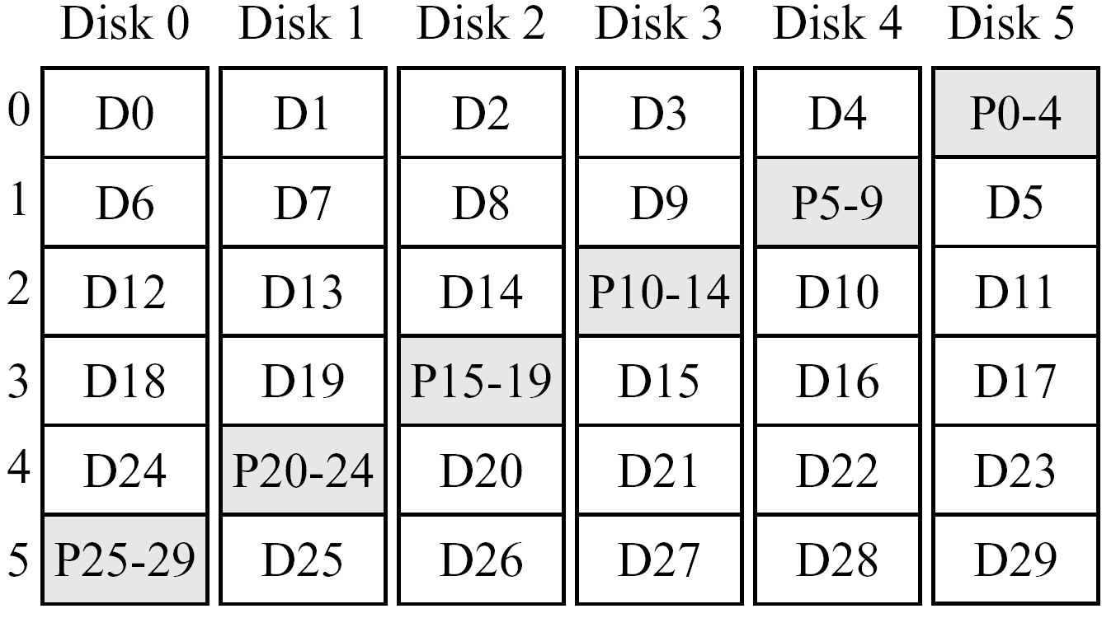
Single disk failure tolerant array
A RAID5 array:
  Rotated block interleaved parity (Left-Symmetric)
  P0-4 = D0 ⊕ D1 ⊕ D2 ⊕ D3 ⊕ D4 (definition)
  P0-4_{new} = D1_{new} ⊕ D1_{old} ⊕ P0-4_{old} (update)
  D0 = D1 ⊕ D2 ⊕ D3 ⊕ D4 ⊕ P0-4 (reconstruct)

Slide 15
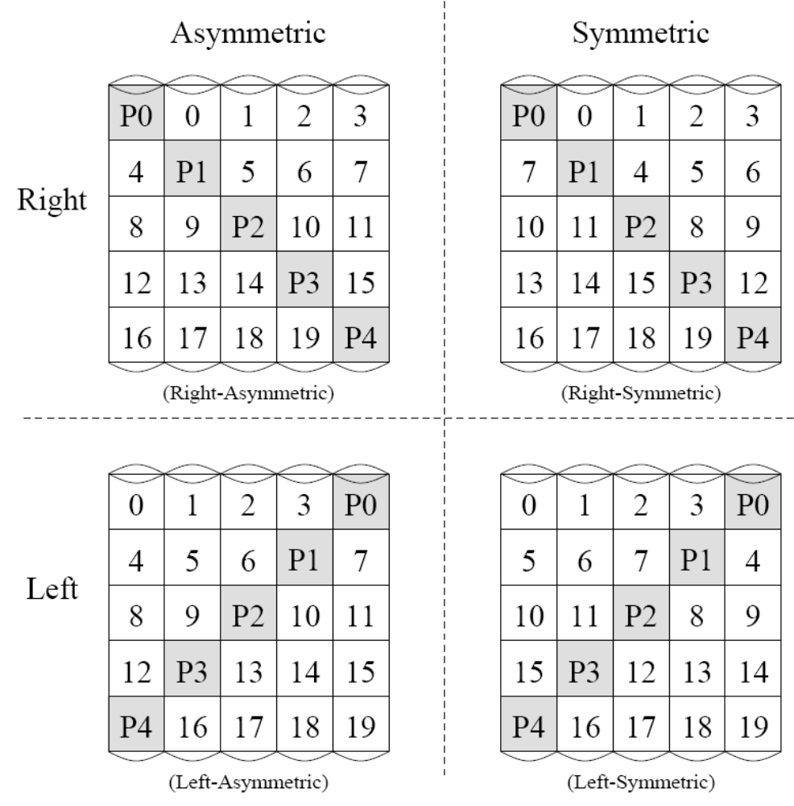
Single disk failure tolerant array

Slide 16
RAID 6: P + Q Redundancy
block 0
block 1
block 2
block 3
P(0-3)
block 4
block 5
block 6
P(4-6)
Q(9 12 15 ...)
block 7
block 8
P(7-9)
Q(3 11 14 ...)
block 9
block 10
P(10-12)
Q(2 6 13 ...)
block 11
block 12
P(12-15)
Q(1 5 8...)
block 13
block 14
block 15
Q(0 4 7 ...)
An extension to RAID 5 but with two-dimensional parity.
Each row has P parity and each row has Q parity.
(Reed-Solomon Codes)
Has an extremely high data fault tolerance and
can sustain multiple simultaneous drive failures
Rarely implemented
More information, please see the paper:
A tutorial on Reed-Solomon Coding for Fault Tolerance in RAID-like Systems

Slide 17
Comparison of RAID Levels
Throughput per Dollar Relative to RAID Level 0
Small Read
Small Write
Large Read
Large Write
Storage Efficiency
RAID 0
1
1
1
1
1
RAID 1
1
1/2
1
1/2
1/2
RAID 3
1/G
1/G
(G-1)/G
(G-1)/G
(G-1)/G
RAID 5
1
max(1/G,1/4)
1
(G-1)/G
(G-1)/G
Raid 6
1
max(1/G,1/4)
1
(G-2)/G
(G-2)/G
G refers to the number of disks in an error correction group.

